Slide 1
Detectability of Surface Biosignatures for Directly Imaged Exoplanets
Gabrielle Jones, Schuyler Borges, Tyler Robinson
ggj8@nau.edu
Department of Astronomy and Planetary Science, Northern Arizona University
NASA Space Grant Presentation 2022

Slide 2
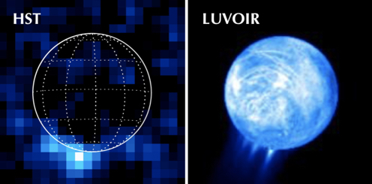
Knowledge Gaps
(Source: NASA)
Unknown if future telescopes can detect surface biosignatures
Notes:
Currently, it is unknown if noise sources and observational techniques will allow future space telescopes to detect surface biosignatures present in the reflected light spectra of exoplanets.

Slide 3
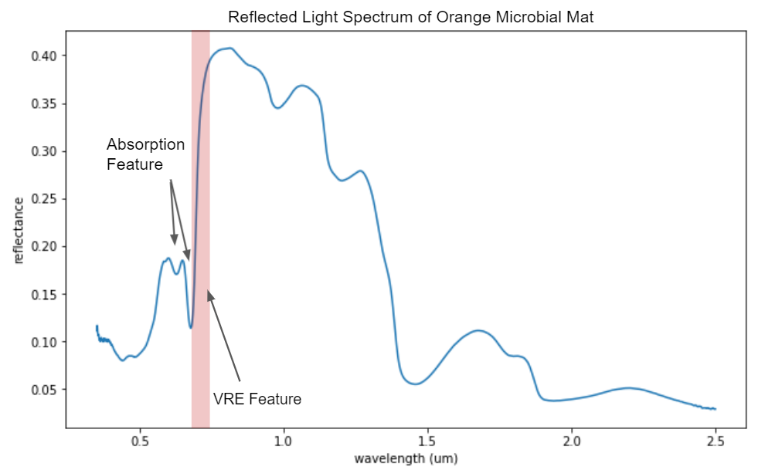
What are Surface Biosignatures?
Notes:
They are features present in a reflected light spectrum that are created from living organisms
The Vegetation Red Edge (VRE) is a spectral feature produced by pigment absorptions in UV/ Vis and scattering in NIR
Pigment absorption features are caused by biological pigments such as chlorophyll a and b

Slide 4
Our Study
Pairs telescope models with models of potentially habitable rocky exoplanets
Quantify the distinguishability of surface biosignatures for photosynthetic, nonphotosynthetic, and anoxygenic photosynthetic microbes
Notes:
And we want to quantify the distinguishability between the VRE and false positives
and isolate the detectability of photosynthetic and non photosynthetic pigments

Slide 5
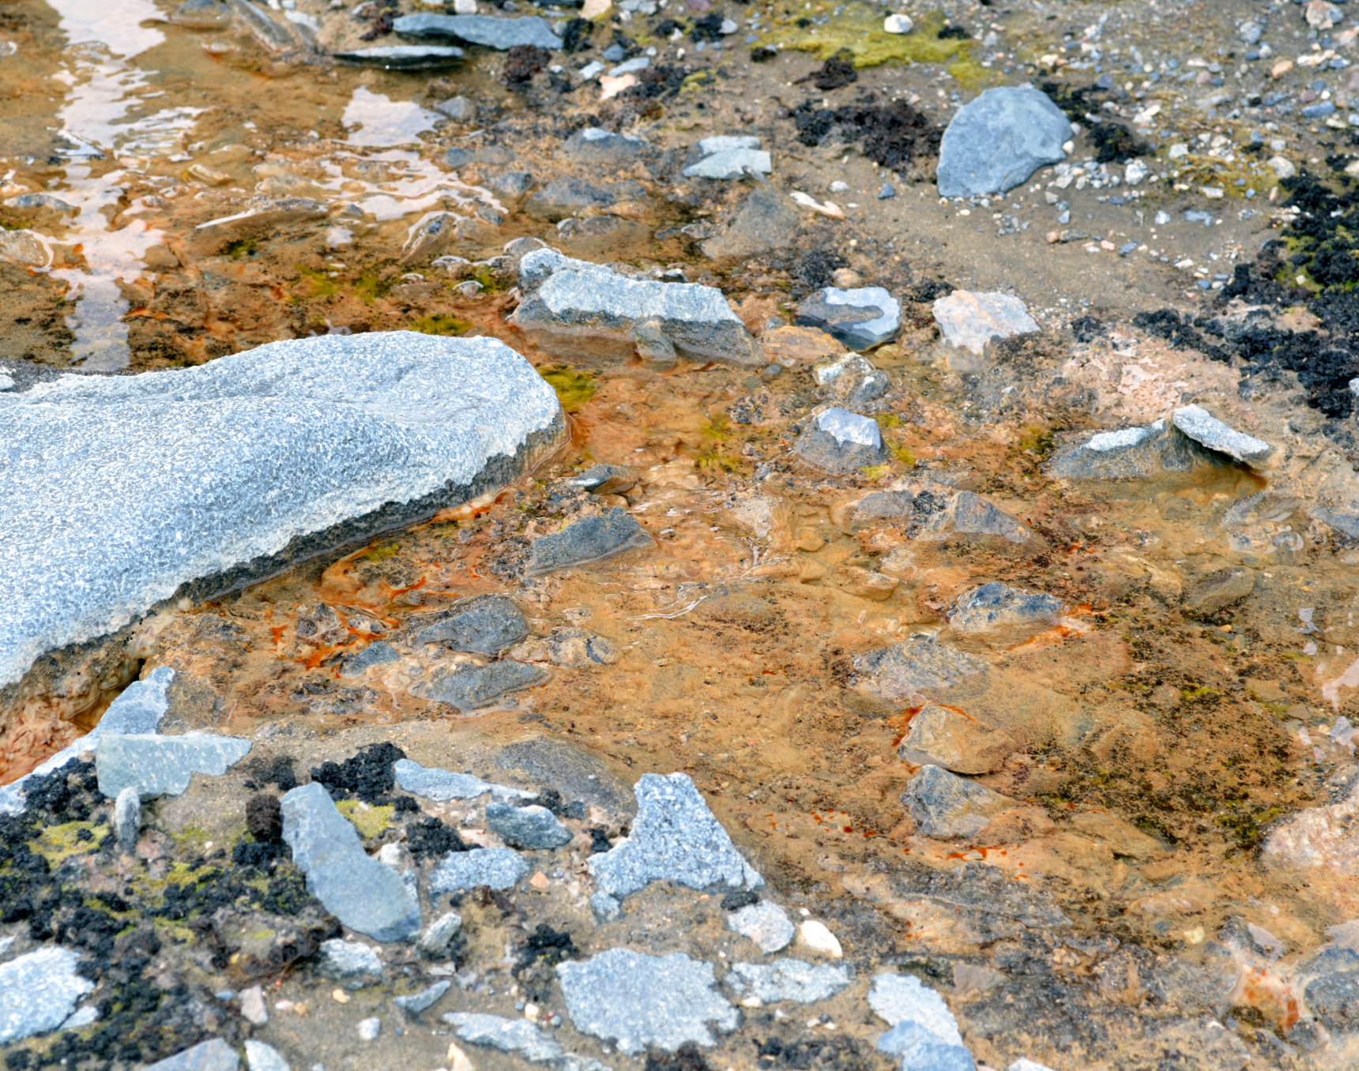
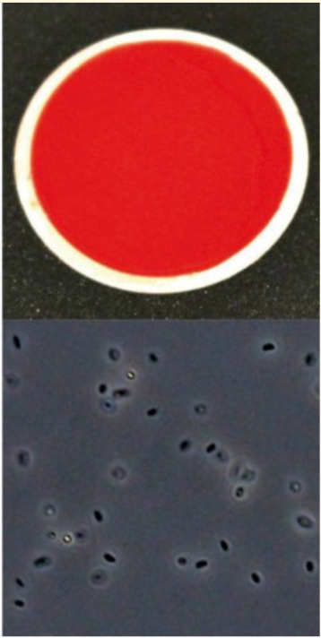
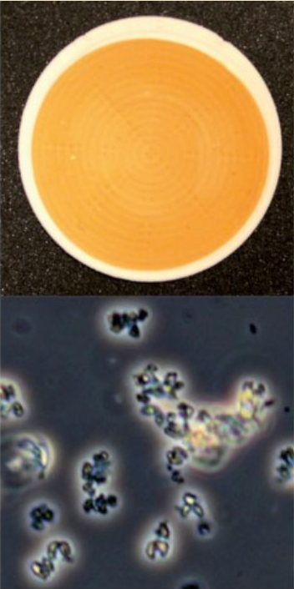
Our Biological Life
Orange and Black Microbial Mats (Source: USAP 2013)
Ectothiorhodospira sp. str. BSL-9, Arthrobacter sp. (Cornell)
Notes:
To quantify our VRE surface biosignature we needed oxygenic photosynthetic communities so we chose orange and black microbial mats
From the McMurdo dry valleys, cold rocky and water-limited environment that we could model on a habitable exoplanet
They have prominent VRE features
Then, we chose both an anoxygenic photosynthetic microbe and a nonphotosynthetic microbe to represent various pigment biosignatures we could detect.
chosen from the cornell spectral biosignature database based on their unique spectral pigmentation
Ectothiorhodospira is a purple sulfur bacterium found at Big Soda Lake to model an Archean Earth or early Mars planet
Arthrobacter is a heterotroph found in the Atacama Desert in Chile to model a cold, arid, rocky, Earth and Mars-like world
Source: http://biosignatures.astro.cornell.edu/

Slide 6
Methods
Create abiotic spectra by removing the VRE and pigment absorption features from our biological spectra
Notes:
To distinguish the detectability of surface biosignatures directly we first

Slide 7
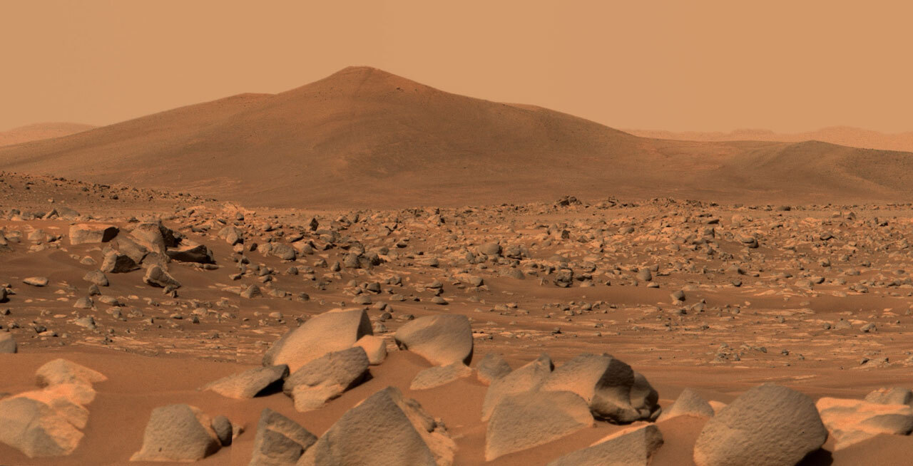
Geological Red Edge
(Source: NASA)
Known that Iron Oxide has a geological red edge
Notes:
It is unknown if noise sources and observational techniques will allow for the detection of surface biosignatures with the presence of false positives
It is known that iron oxide has a geological red edge

Slide 8
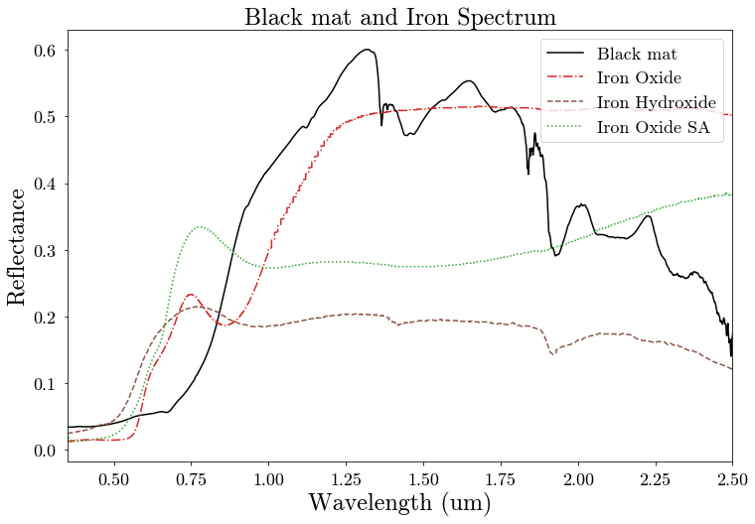
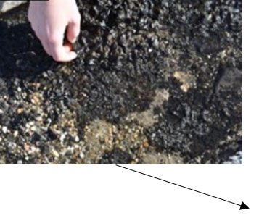
Notes:
Explain how the iron oxide slope was averaged and used to scrub the VRE feature in our black mat spectrum

Slide 9
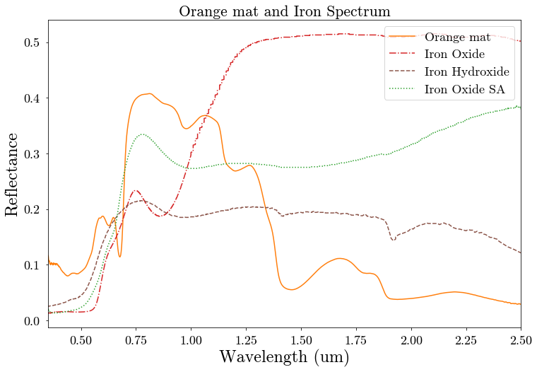
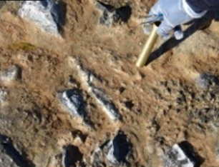
Notes:
The same process for orange mat

Slide 10
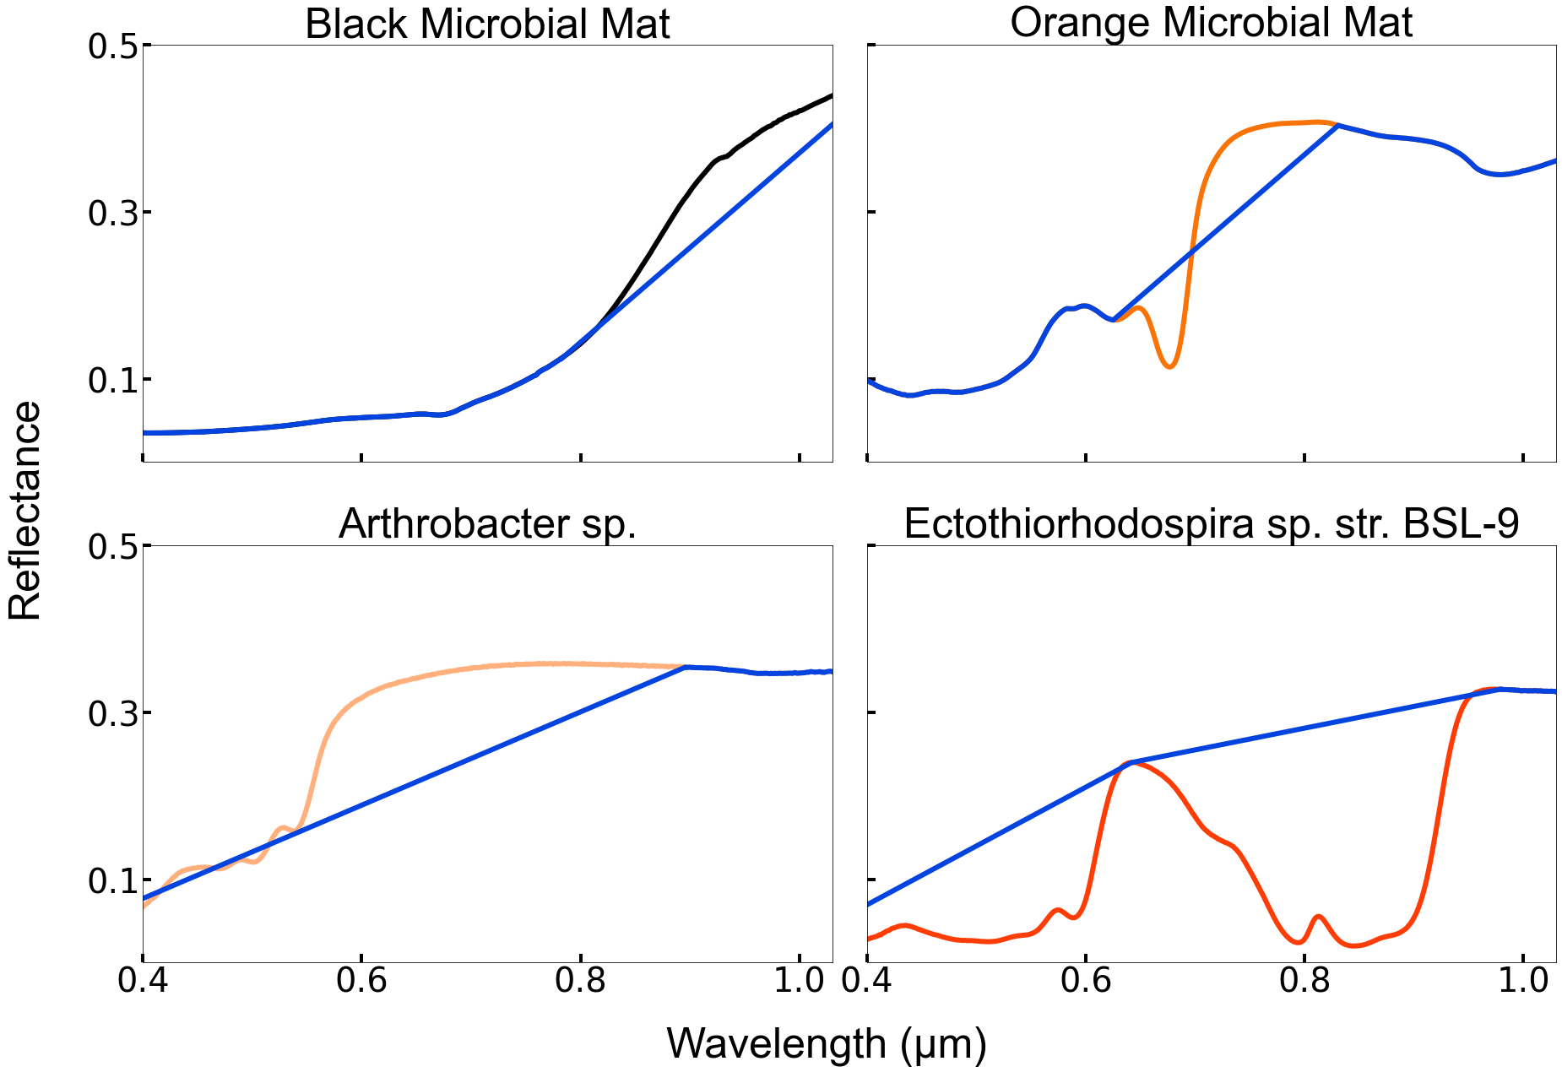
Notes:
This plot shows the surface spectra with their features removed in blue, *explain the process for scrubbed pigments* “We replaced the biological red edge in our black and orange mat spectra with this average iron oxide red edge to produce our reference spectrum”
“For Ectothiorhodospira sp. str. BSL-9 and Arthrobacter sp., we simply removed the pigment features from their measured spectra to create our reference spectra”

Slide 11
Methods
Run spectra through SMART (Meadows et al. 1996) with clear and cloudy skies to produce top of the atmosphere radiance
Mix our SMART spectra to produce cloud coverage percentages of 25%, 50% and 75%
Notes:
Next we simulated what the surface would look like through an earth-like atmosphere
Spectral Mapping Atmospheric Radiative Transfer (SMART) model
we generated an atmospheric spectrum that contained these surface biosignatures

Slide 12
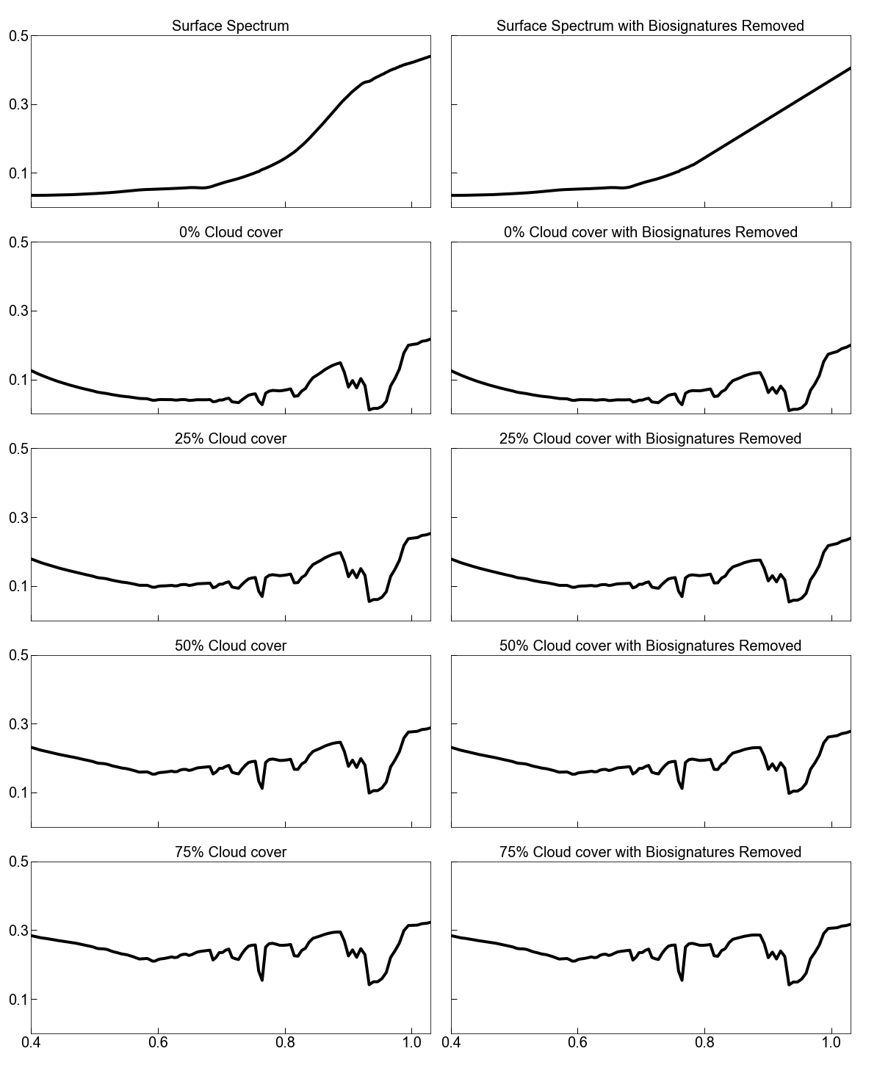
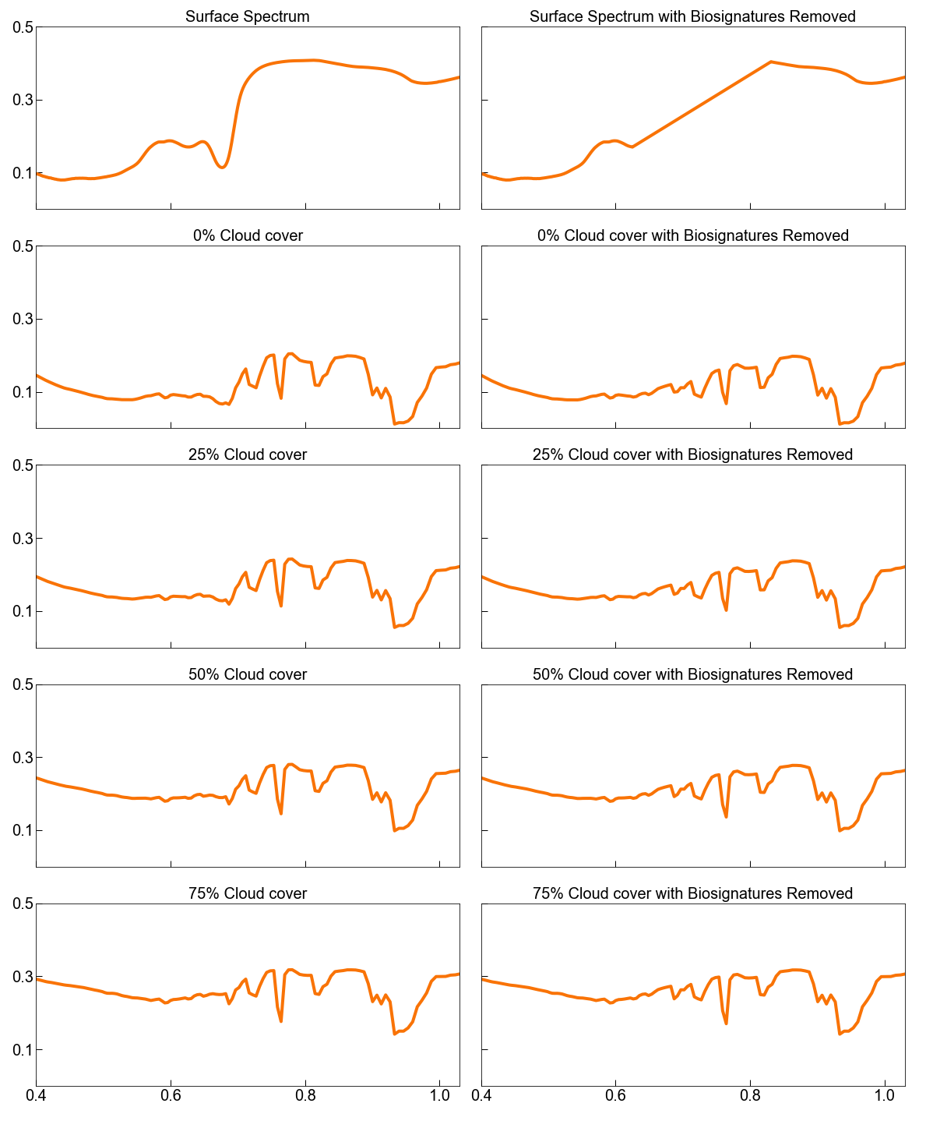
Black Microbial Mat
Orange Microbial Mat
Reflectivity
Wavelength (um)

Slide 13
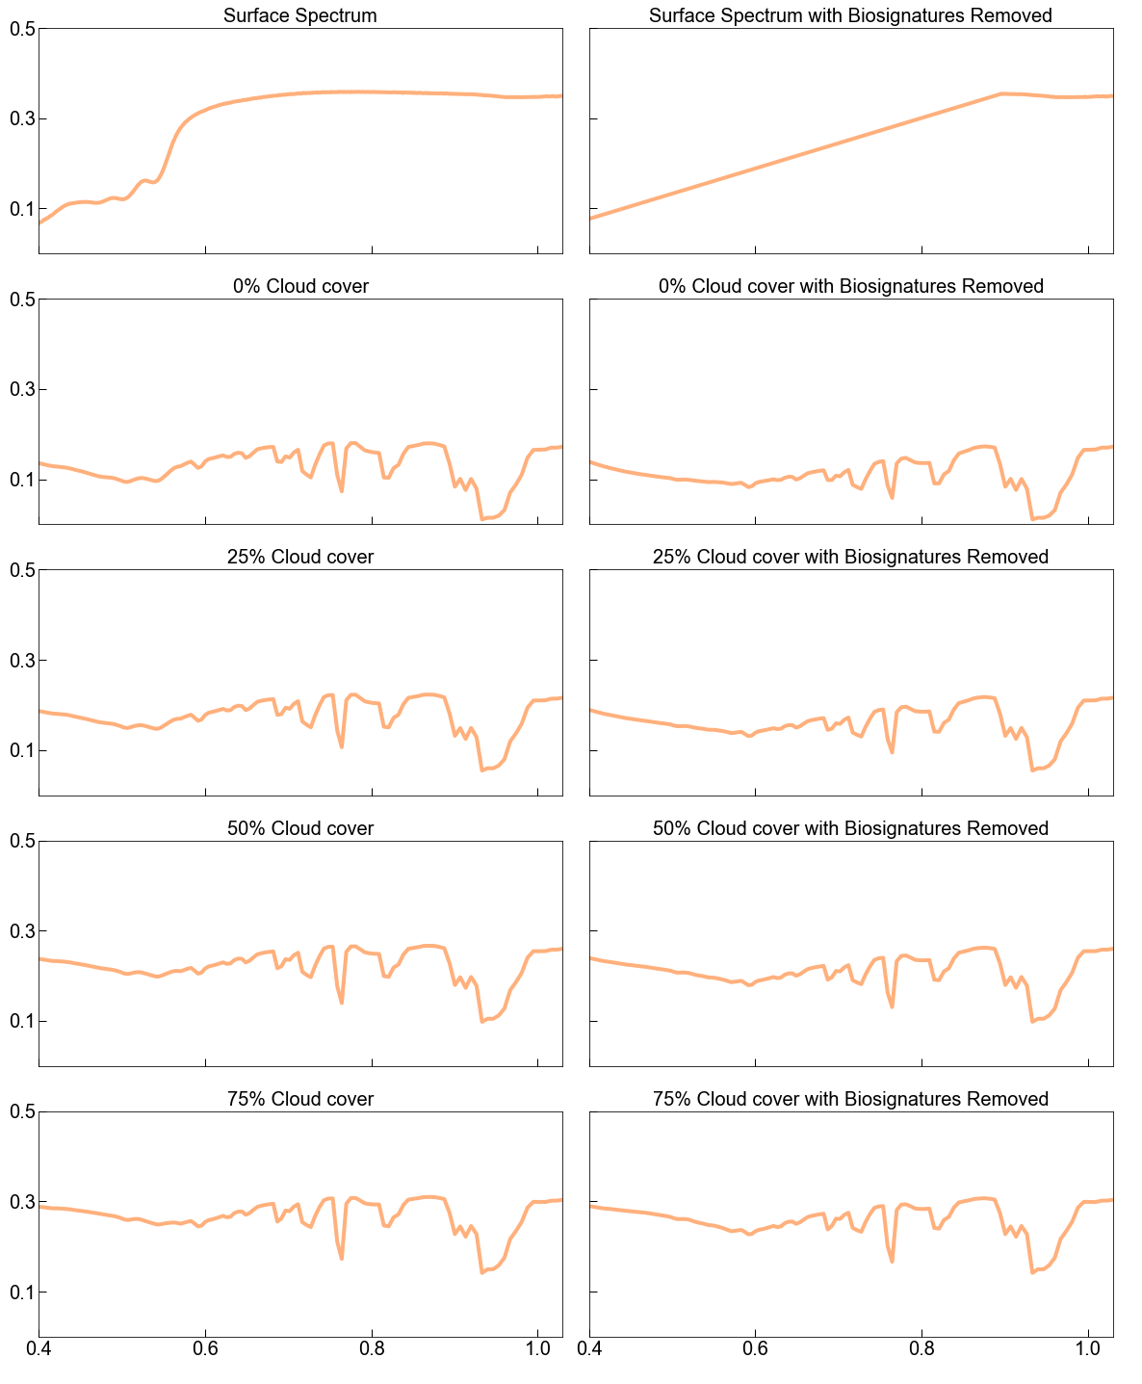
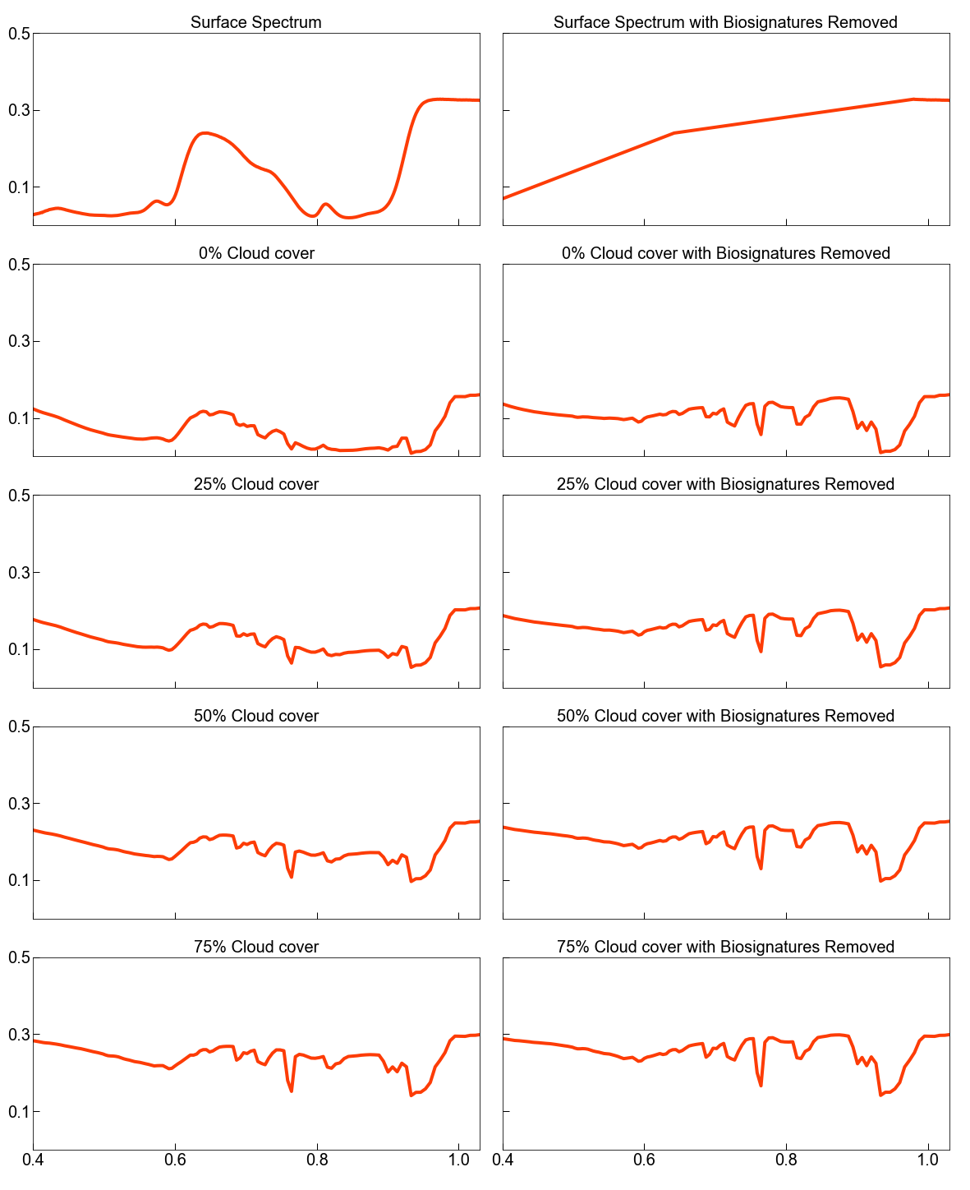
Arthrobacter sp.
Ectothiorhodospira sp. Str. BSL-9
Reflectivity
Wavelength (um)

Slide 14
Methods
Run radiance spectra through our LUVOIR noise model (Lustig-Yaeger et al. 2020 & Robinson et al. 2016) to compute detection times for each spectra
Notes:
We could then input these reflectivities into our LUVOIR noise model. *explain how the model works*
we determined the exposure time needed to detect the biological red edge and non-oxygenic photosynthetic pigments in a spectrally resolved exoplanet spectrum using LUVOIR.

Slide 15
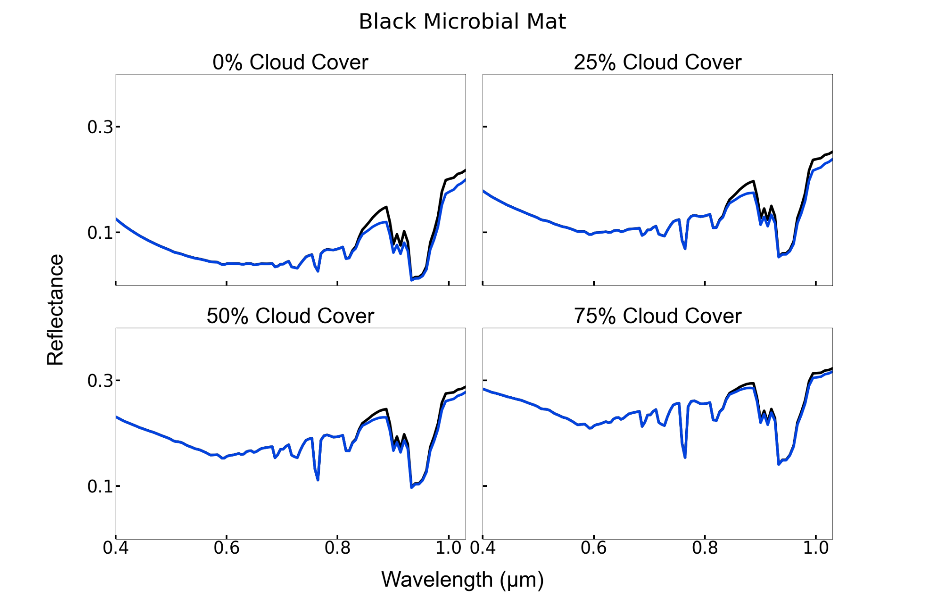
Cloud % | Dt (hr)
0% | 3.81e+6
25% | 1.82e+6
50% | 1.99e+6
75% | 4.12e+6

Slide 16
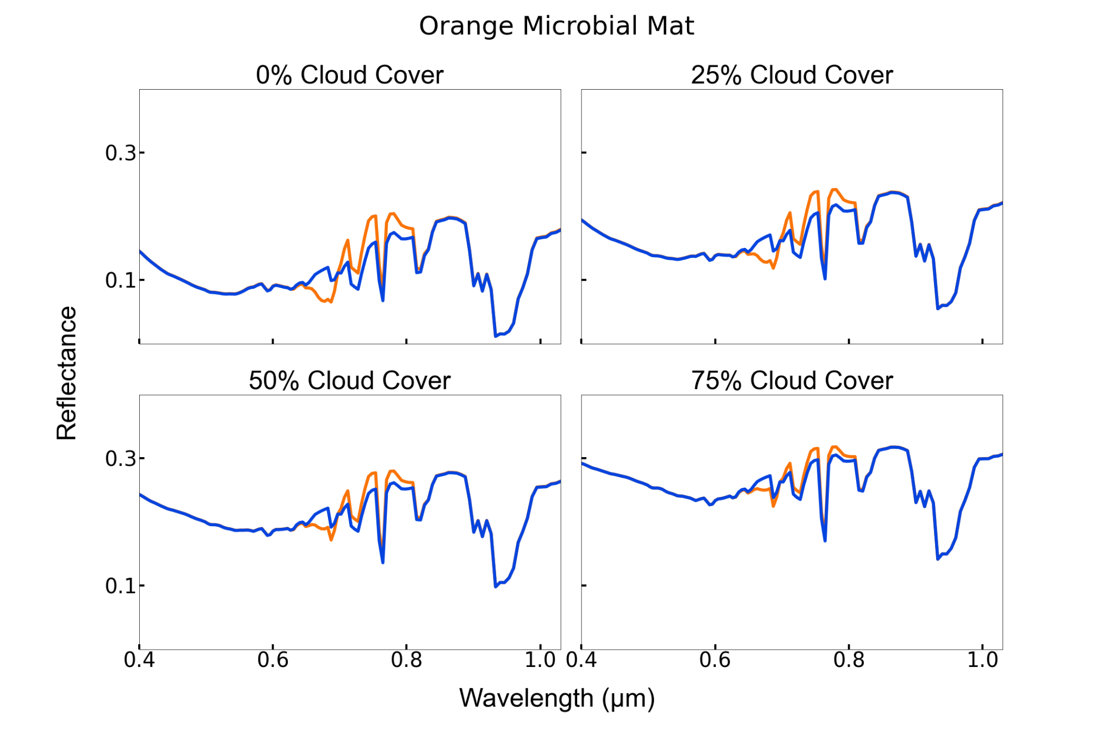
Cloud % | Dt (hr)
0% | 337.377
25% | 318.646
50% | 374.702
75% | 587.844

Slide 17
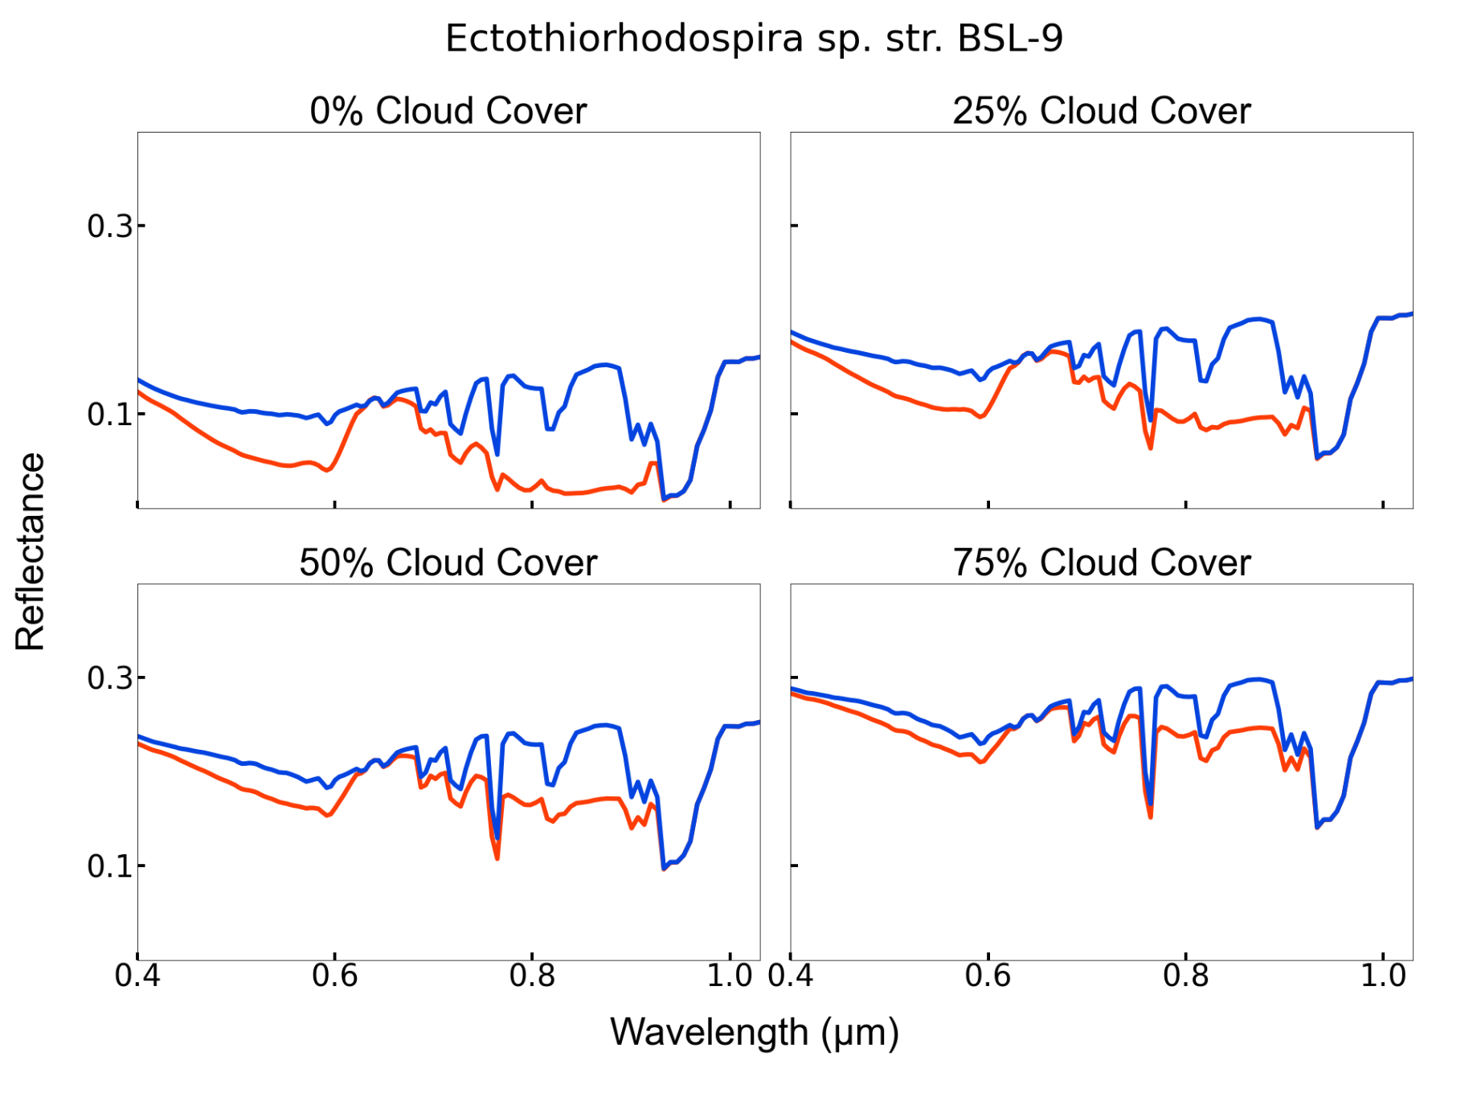
Cloud % | Dt (hr)
0% | 330.759
25% | 108.267
50% | 84.2454
75% | 110.921

Slide 18
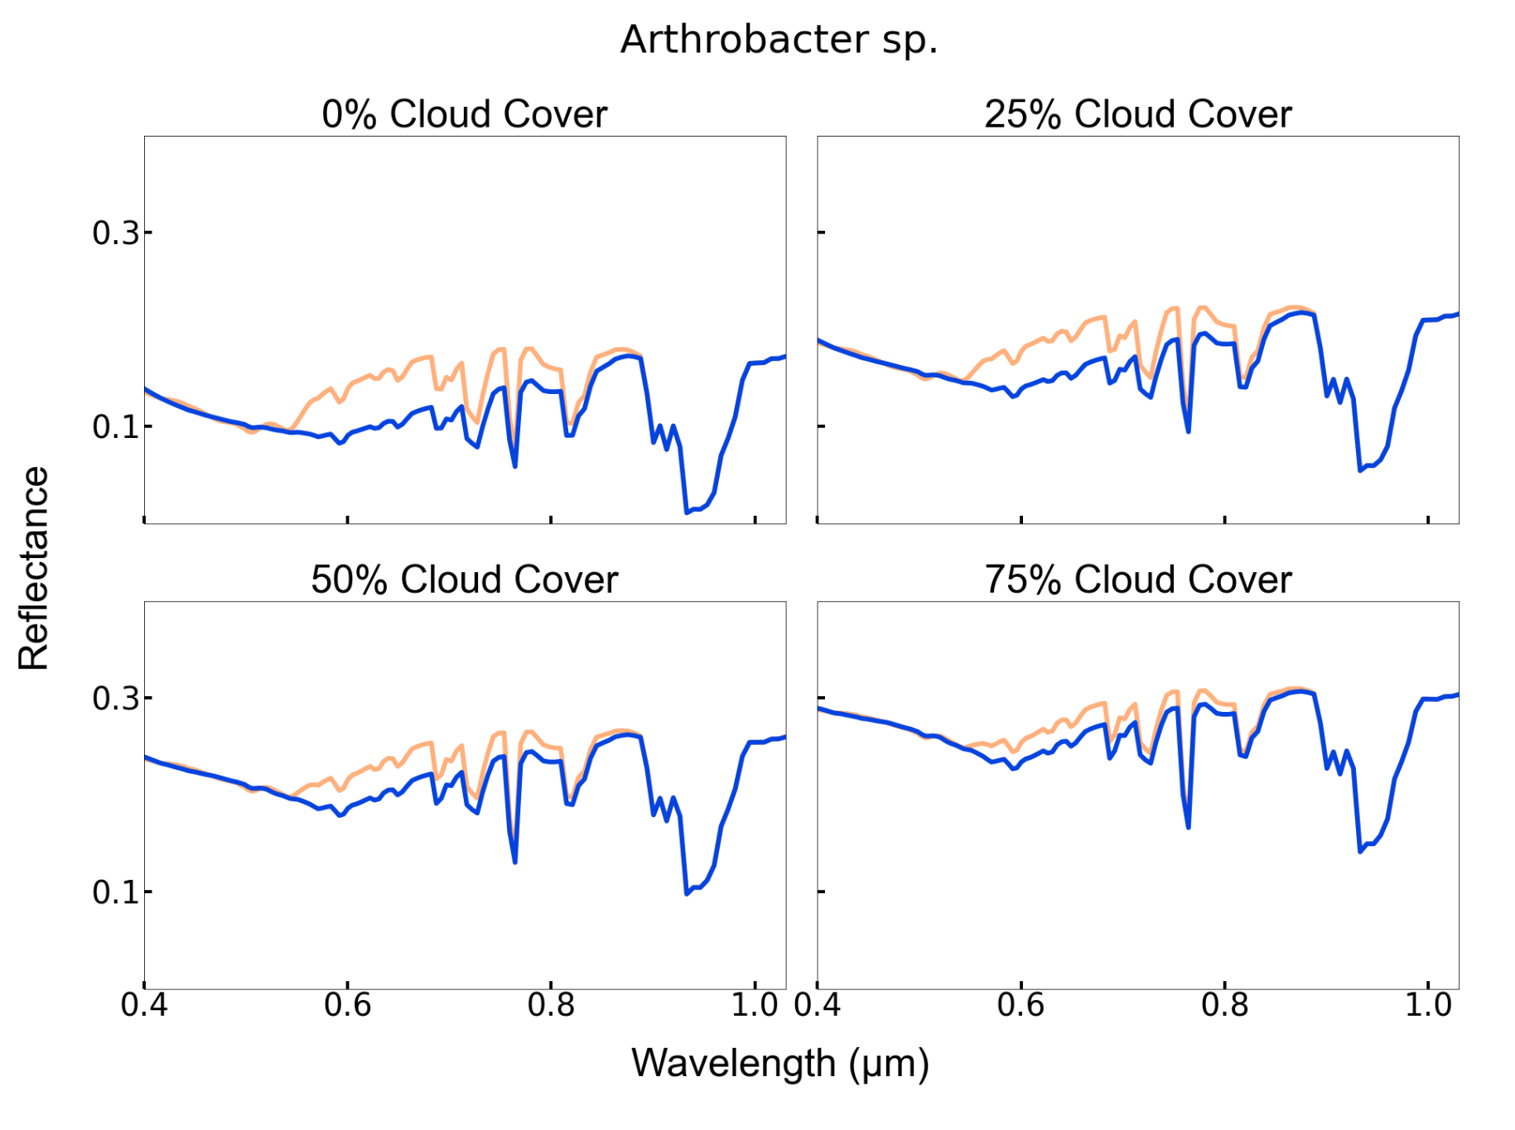
Cloud % | Dt (hr)
0% | 84.5114
25% | 85.5114
50% | 106.501
75% | 173.074

Slide 19
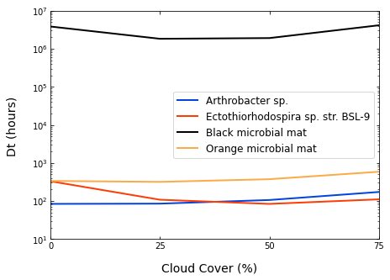
Notes:
Our results prove that is is not feasible to detect black mat when a false positive red edge is present and that non the photosynthetic microbe, arthrobacter is generally the fastest to detect but the anoxygenic photosynthetic microbe, Ectothiorhodospira sp. str. BSL-9, is also relatively faster to detect with increasing cloud cover

Slide 20
Why is this important?
Combining telescope noise models with models of habitable worlds can aid in our understanding of detecting surface biosignatures on exoplanets
Source: NASA JPL, 2015
Notes:
Reflectance is dominating Dt not biosignatures so to isolate the biosignature we are going to create a spectrum that has those features not present in it to really focus on those signatures.
Going to test other extremophiles with non-photosynthetic pigments and without VRE

Slide 21
Why is this important?
A false positive biosignature influences the detectability of the surface biosignature
Source: NASA JPL, 2015
Notes:
Reflectance is dominating Dt not biosignatures so to isolate the biosignature we are going to create a spectrum that has those features not present in it to really focus on those signatures.
Going to test other extremophiles with non-photosynthetic pigments and without VRE

Slide 22
Why is this important?
Nonphotosynthetic and anoxygenic photosynthetic biosignatures were the quickest to detect
Source: NASA JPL, 2015
Notes:
Reflectance is dominating Dt not biosignatures so to isolate the biosignature we are going to create a spectrum that has those features not present in it to really focus on those signatures.
Going to test other extremophiles with non-photosynthetic pigments and without VRE

Slide 23
Thank you!
Sources:
Jacob Lustig-Yaeger, Tyler D. Robinson, & Giada Arney. (2019). coronagraph: Telescope Noise Modeling for Exoplanets in Python (v1.0). Zenodo. https://doi.org/10.5281/zenodo.3375103
Meadows, V. S., and D. Crisp. 1996. “Ground-Based near-Infrared Observations of the Venus Nightside: The Thermal Structure and Water Abundance near the Surface.” Journal of Geophysical Research: Planets 101 (E2): 4595–4622. https://doi.org/10.1029/95je03567.
NASA JPL, 2015 (https://www.nasa.gov/feature/jpl/20-intriguing-exoplanets)
O’Malley-James, Jack T., and Lisa Kaltenegger. 2018. “The Vegetation Red Edge Biosignature through Time on Earth and Exoplanets.” Astrobiology 18 (9): 1123–36. https://doi.org/10.1089/ast.2017.1798.
Robinson, Tyler D., Karl R. Stapelfeldt, and Mark S. Marley. 2016. “Characterizing Rocky and Gaseous Exoplanets with 2m Class Space-Based Coronagraphs.” Publications of the Astronomical Society of the Pacific 128 (960): 1–22. https://doi.org/10.1088/1538-3873/128/960/025003.
Schwieterman, Edward W., Charles S. Cockell, and Victoria S. Meadows. 2015. “Nonphotosynthetic Pigments as Potential Biosignatures.” Astrobiology 15 (5): 341–61. https://doi.org/10.1089/ast.2014.1178.
USAP 2013 (https://photolibrary.usap.gov/PhotoDetails.aspx?filename=dry-valleys-bacterial-mats.jpg)

